Slide 1
Nationalism and Regionalism in Spain: Sentiments of Spanish Identity throughout History
Advisor: Donaldo Urioste
By: Sierra Stapp

Slide 2
What is Nationalsim and Regionalism?
My capstone is an investigation about the identity of the Spanish and how they feel in relation to their nation or region.
Nationalism is a belief or political ideology that involves an individual identifying with, or becoming attached to, one's nation.
Regionalism is a political ideology that focuses on the interests of a particular region or group of regions, whether tradition or formal. Can also be called sub-nationalism.

Slide 3
A better understanding…
We can relate with how we identify ourselves based on our feelings toward our nation or region.
Most of us here today are probably from California. If you’re on an international trip, do you tell people you’re from the United States or that you’re from California? Are you a Californian first, or an American first?
Some of us have stronger ties toward our region rather than our country. The same occurs in Spain, but there is much more division within the country because of the lasting effects of the Civil War

Slide 4
Survey from the ‘90s
This survey gives us the percentages of the Spanish population that either identified with their region or with Spain.
They were given 6 options to choose from:
You only identify with Spain
You identify with Spain more than with your region
You identify with your region and with Spain the same
You identify with your region more than with Spain
You only identify with your region
I don’t know

Slide 5
Results
You only identify with your region
You identify with your region more than with Spain
You identify with your region and with Spain the same
You identify with Spain more than with your region
You only identify with Spain
I don’t know
Nearly half of the Spanish population identified themselves as both Spanish and from their region.
Just 9% of the population only identified with their region.
We can conclude that there was less division within the Spanish people in the ’90s. Which regions had a higher population of those who identified with just their region?

Slide 6
Breaking down the results by region
I don’t know
You only identify with Spain
You identify with Spain more than with your region
You identify with your region and with Spain the same
You identify with your region more than with Spain
You only identify with your region
Regions that have a higher population that identify only as Spanish are: Madrid, Castilla la Mancha and Catabria
Basque Country, Canary Islands and Galicia have a higher population that identifies only with the region.
Take note of how most of Catalonia’s population identifies at least partly as Spanish and not just the region.

Slide 7
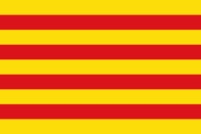
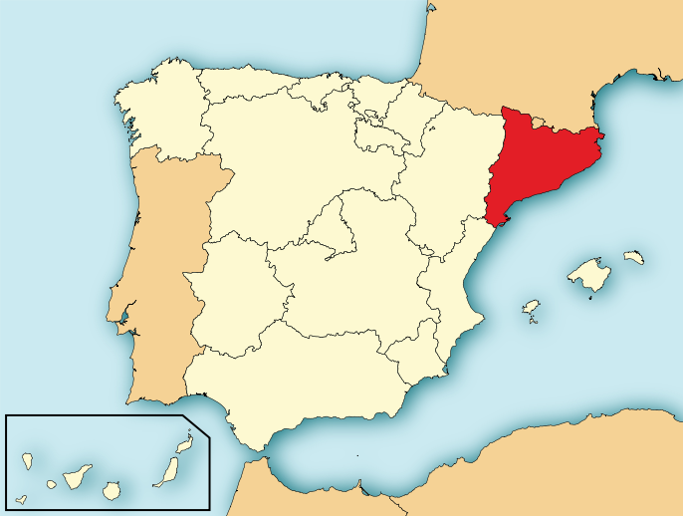
Catalonia in the 20th Century
Regionalism or Catalan Nationalism is called Catalanismo
During the Second Republic in Spain (1931) Catalonia had autonomy, but it was abolished by the dictator Franco in 1939 after the end of the Civil War (1936-1939)
There were laws restricting the use of their native language during Franco’s regime and they were also culturally and politically oppressed.
Their form of rebellion toward Franco was through an underground cultural revival through art and literature that fostered the Catalan identity.

Slide 8
Catalonia Today
Today, Catalonia has autonomy and their own president, Artur Mas.
In 2006 they were granted a statute that allowed them more power to govern the region.
There has been a large movement toward Catalan independence since 2012, caused by the economic crisis in Spain
The region plans to hold a vote on a referendum in November of this year that would ask two questions: Do you want Catalonia to be a state? If yes, Do you want Catalonia to be an independent state?
Independence is illegal, stated on the 1978 Constitution, and the region was denied approval in April by all political parties except the Nationalist Basque Country.

Slide 9
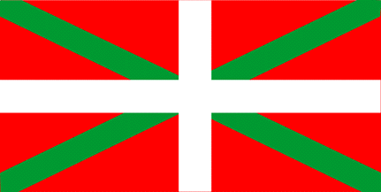
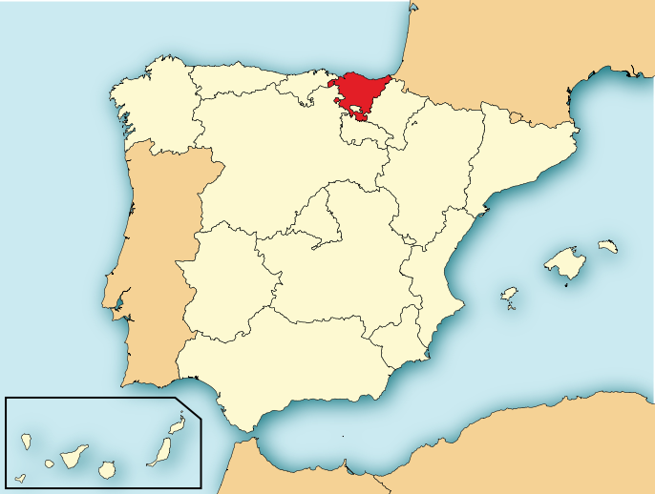
Basque Country 20th Century
There were laws restricting the use of their native language during Franco’s regime and they were also culturally and politically oppressed, the same as Catalonia
In 1956 the organization ETA, or Basque Homeland and Freedom, was created in response to Franco’s regime.
They are responsible for 829 deaths, terrorism, and kidnappings.
They have declared a cease-fire 5 times, the last being in 2010, which still stands.

Slide 10
Basque Country Today
The majority of the people in Basque Country have voted for the Nationalistic Basque parties since the transition into democracy in 1975
There are various forms of Basque nationalism, from the moderate to the radical, like the ETA.
There are several conceptions on how to configure their autonomous region now, with independence, or a more federalist government

Slide 11
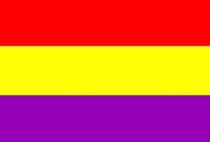
Anthem to the Three Colored Flag
Hermosa flor,
La ardiente primavera
Nos ha tornado la bandera
De la esperanza entera:
¡Trabajo, alegría y amor!
¡Viva la libertad verdadera!
¡Viva la igualdad verdadera!
¡Viva la fraternidad verdadera!
Sobre el tedio, la sombra y el rencor,
¡al cielo de la paz la bandera,
A la tierra de todos la bandera,
Al mar hermano la bandera
De nuestra vida entera!
¡Trabajo, alegría y amor!
Beautiful flower,
The blazing spring
It has become our flag
Of hope entirely:
Work, happiness and love!
Long live true freedom!
Long live true equality!
Long life true brotherhood!
About the tedium, shadow and resentment,
To peaceful heavens with the flag
To everyone’s land with the flag
To brother sea with the flag
To our whole life!
Work, happiness and love!
Juan Ramón Jimenéz

Slide 12
Analysis and History
The three colored flag was the flag during the Second Republic (1931-1939), before the dictatorship of Franco and after the dictatorship of Primo de Rivera
The republicans were those against Franco during the Civil War
The three colors represent liberty, equality and brotherhood
This poem is by Juan Ramon Jimenez, and it was his first political poem. He wrote it right after the government was established and he published it in a newspaper under an anonymous name.
He uses allegory and identifies the three colors as work, happiness and love. We can see how they correlate.
He is emotional about this transition and that is clearly portrayed in this poem.
Analysis by Arturo del Villar

Slide 13
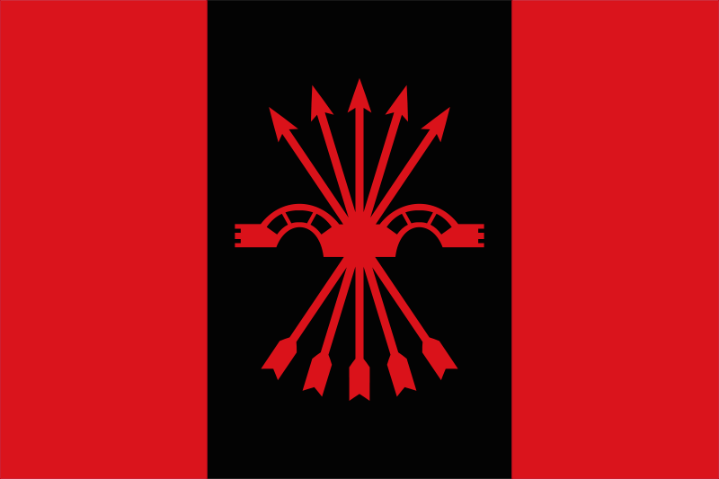
Cara al Sol
Anthem of the Falangist Party
by José Antonio Primo de Rivera and Agustín de Foxá
Cara al Sol con la camisa nueva,
Que tu bordaste en rojo ayer,
Me hallara la muerte si me lleva
Y no te vuelvo a ver.
Formaré junto a mis compañeros
Que hacen guardia sobre los luceros
Impasible el ademán,
Y están presentes en nuestro afán.
Si te dicen que caí,
Me fui al puesto que tengo allí.
Volverán banderas victoriosas
Al paso alegre de la paz
Y traerán prendidas cinco rosas
Las flechas de mi haz.
Volverá a reír la primavera,
Que por cielo, tierra y mar se espera.
¡Arriba, escuadras, a vencer,
Que en España empieza a amanecer!
¡España una!
¡España grande!
¡España libre!
¡Arriba España!
Facing the sun in my new shirt
that you embroidered in red yesterday,
That's how death will find me if it takes me and I won't see you again.
I'll take my place alongside my companions who stand on guard in the heavens,
with a hard countenance, they are alive in our effort.
If they say to you that I fell,
know that I'm gone to my post up there.
Victorious flags will return
at the merry step of Peace
and they'll bring five roses
the arrows of my quiver.
Spring will laugh again,
which we await by air, land and sea. Onwards, squadrons, to victory,
that a new day dawns on Spain!Spain united! Spain (the) great! Spain (the) free! Onwards Spain!

Slide 14
Analysis and History
This is the anthem for the fascist party in Spain, the only party to exist during Franco’s dictatorship
It was written by José Antonio Primo de Rivera (the first dictators eldest son), Agustín Foxá and other members of the party
Quote from José Antonio Primo de Rivera “Our anthem should be a happy song, that exempts hate, but also be of war and love. We have a stanza about the lover, after an allusion to the eternal guard in the stars and another stanza about victory and peace.”
The reference to the "new shirt" relates to the falangist uniform: a working class, plain blue shirt which was their most distinctive sign. The party symbol is a yoke with five arrows centered and pointing upwards, meaning strength, sacrifice and union. There is a reference to the symbol towards the middle of the anthem. Spain united, great and free was a frequently used slogan in Franco’s time. “Onward Spain” was used by the falangists instead of the more frequently used “Long Live Spain.”
The Falangists wanted a central government opposed to a Republic

Slide 15
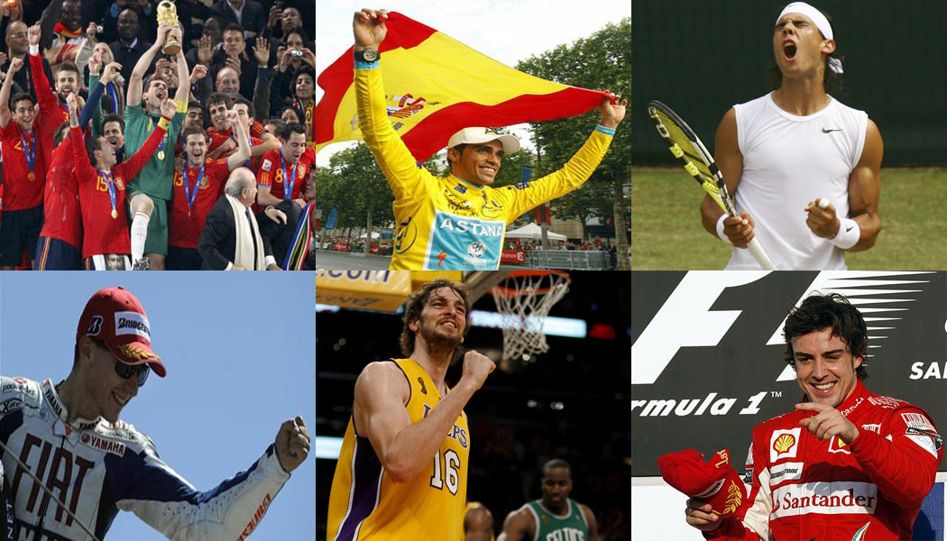
A reason for Spanish Pride
Over the past decade, we have seen Spain’s soccer team win the Euro Cup and the World Cup, Rafael Nadal win several opens in tennis, Spain’s basketball team (including Pau Gasol from the LA Lakers) receive silver in the last two Olympics, Fernando Alonso be the face of Formula One racing, and Alberto Contador win the Tour de France.

Slide 16
A reason for Spanish Pride…
These athletes, several of them being Catalonian and even Basque, have created a new unity in the country. Most, if not all, of the players identify both regionally and nationally. There is no division on the Spanish soccer team between those from Madrid and those from Catalonia, even though during the regular season the competition is strong between Madrid and Catalonia. The Spanish flag during the world cup was not perceived as a sign of Franco or fascists, but as a sign of hope and pride for all who supported “la Roja.” The majority of the athletes were born after 1975, that’s to say, they were born post Franco, giving them fewer reason to be against one another and this unity has spread throughout the country.

Slide 17
Questions? Comments?

